Slide 1


Network protocols & security
24EC2210
Topic:
Tunneling, NAT and PAT
Session – 18&19

Slide 2



AIM OF THE SESSION
To familiarize students with the Tunneling, NAT and PAT protocols.
INSTRUCTIONAL OBJECTIVES
This Session is designed to:
Describe the functionality of Tunneling.
Describe the functionality of NAT and PAT Protocols.
LEARNING OUTCOMES
At the end of this session, you should be able to:
Illustrate the importance of Tunneling.
Demonstrate the functionality of NAT process.
Demonstrate the functionality of PAT process.

Slide 3
IP Tunneling

Slide 4
TUNNELING
Tunneling is a technique of inter-networking used when source and destination networks of the same type are to be connected through a network of different types.
Tunneling uses a layered protocol model such as those of the OSI or TCP/IP protocol suite.
Tunneling is dealing with different levels of the specified protocol while moving between different layers and data conversion (Encapsulation) to suit different interfaces of a particular layer.

Slide 5
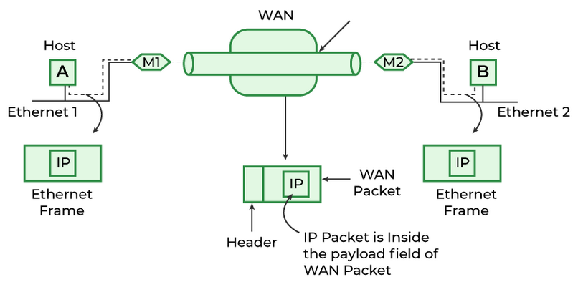
TUNNELING…
Example: Consider an Ethernet to be connected to another Ethernet through a WAN.
The task is sent on an IP packet from host A of Ethernet-1 to host B of Ethernet-2 via a WAN.

Slide 6
TUNNELING…
Steps Involved:
Host A constructs a packet that contains the IP address of Host B.
It then inserts this IP packet into an Ethernet frame and this frame is addressed to the multiprotocol router M1
Host A then puts this frame on Ethernet.
When M1 receives this frame, it removes the IP packet, inserts it in the payload packet of the WAN network layer packet, and addresses the WAN packet to M2. This process is called encapsulation.
The multiprotocol router M2 removes the IP packet and sends it to host B in an Ethernet frame.
Encapsulation is the process of adding a new packet within the existing packet or a packet inside a packet.

Slide 7
TUNNELING…
Why is this Technique Called Tunneling?
In this particular example, the IP packet does not have to deal with WAN, and the host’s A and B also do not have to deal with the WAN.
The multiprotocol routers M1 and M2 will have to understand IP and WAN packets.
Therefore, the WAN can be imagined to be equivalent to a big tunnel extending between multiprotocol routers M1 and M2 and the technique is called Tunneling.

Slide 8
NAT

Slide 9
Network Address Translation (NAT)
32-bit IP address become scarce due to its limitation in the number of addresses.
Scenario can be like having IP address assigned dynamically, that is, when required we get an IP address from ISP, and when the session is terminated it can be allocated to some other.
But people working in business applications needs to access internet continuously.
NAT is used to reduce the no. of IP addresses that an organization needs.

Slide 10
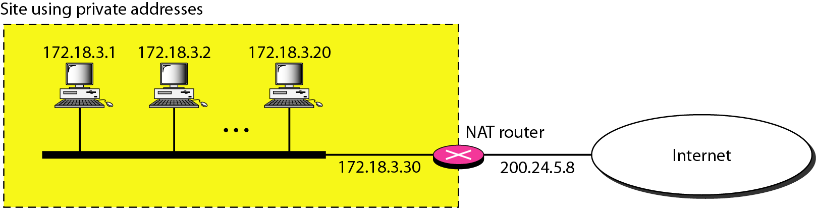
Network Address Translation (NAT)
Assign each company a single IP address(Public) for internet traffic.
Within the company, every computer gets a unique IP address(Private) to manage intramural traffic.
Whenever a packet exits the company and goes to the ISP, an address translation(Private to Public) takes place.
A Network Address Translation (NAT) is the process of mapping an internet protocol (IP) address to another by changing the header of IP packets while in transit via a router. This helps to improve security and decrease the number of IP addresses an organization needs.

Slide 11
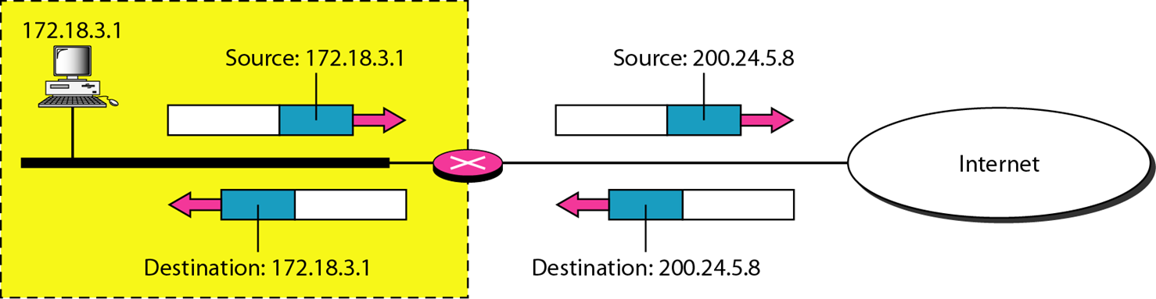
Network Address Translation (NAT)
Addresses in a NAT
Private addresses :
10 . 0 . 0 . 0 - 10 . 255 . 255 . 255 / 8
172 .16 . 0. 0 - 172. 31 . 255 . 255 /12
192 .168 . 0 . 0 - 192 . 168 . 255 . 255 /16

Slide 12
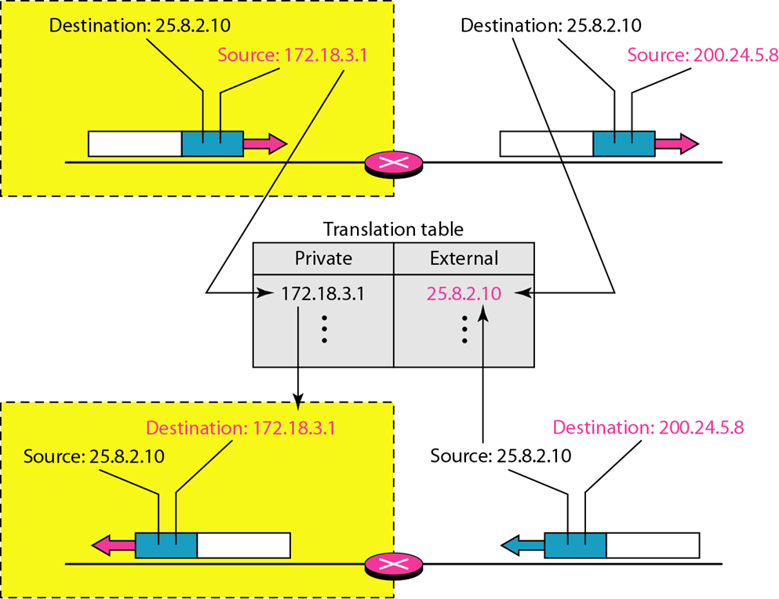
Network Address Translation (NAT)
NAT address translation process:
Source Private IP: 172.18.3.1
Destination IP: 25.8.2.10
Network public IP: 200.24.5.8
These two addresses are recorded in NAT table and the packet is transferred to destination.
Packet while moving to destination, its source private address is changed to public address by NAT.
When an ACK packet is received from destination (Source IP: 25.8.2.10, Destination IP: 200.24.5.8), then NAT will check the table to see if ACK source IP is equal to external address.
If so, then the ACK destination public IP is changed to private IP.

Slide 13
PAT

Slide 14
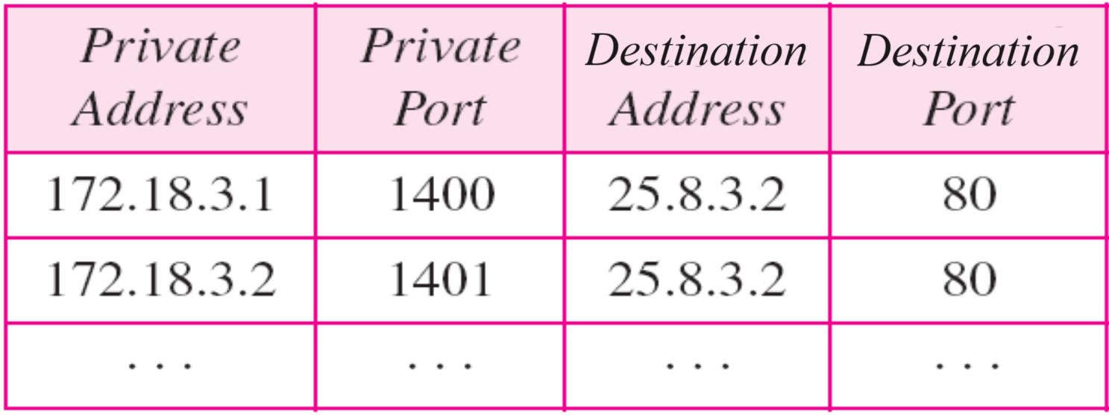
Port Address Translation (PAT)
Port Address Translation (PAT) is a specific type of Network Address Translation (NAT) technique which is used in computer networking.
PAT is commonly implemented in routers to allow multiple devices within a private network to share a single public IP address due to which it is sometime referred as NAT Overload.
The main task of Port Address Translation (PAT) is to map multiple private IP addresses to a single public IP address by using unique port numbers.
In PAT, Private IP addresses are translated into the public IP address via Port numbers.

Slide 15
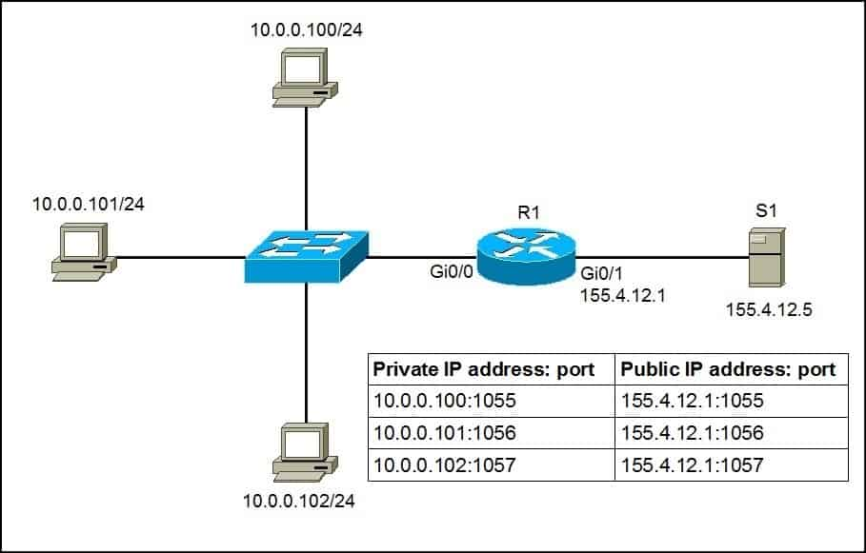
Port Address Translation (PAT) …

Slide 16

SUMMARY
Tunneling
NAT Protocol
PAT Protocol

Slide 17
TERMINAL QUESTIONS
Demonstrate the concept of Tunneling in an internet with an example.
With a neat sketch describe the functionality of NAT.
With a neat sketch describe the functionality of PAT.

Slide 18
REFERENCES FOR FURTHER LEARNING OF THE SESSION
Reference Books:
Behrouz A. Forouzan , “Data Communication and Networking”, TMH, 5th Edition, 2012.
A.S. Tanenbaum, David J. Wetheral “Computer Networks” Pearson, 5th Edition.

Slide 19
THANK YOU
Team – Network Protocols & Security

